Slide 1
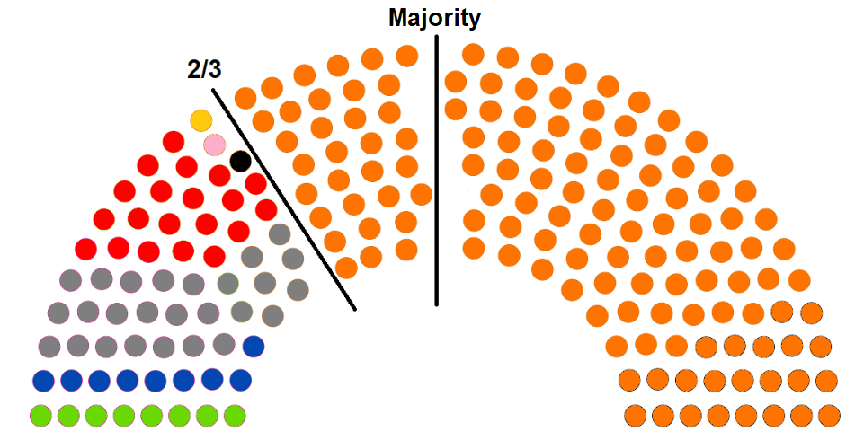
Election prediction
Predicting and analyzing the results of the 2018 Hungarian general elections

Slide 2
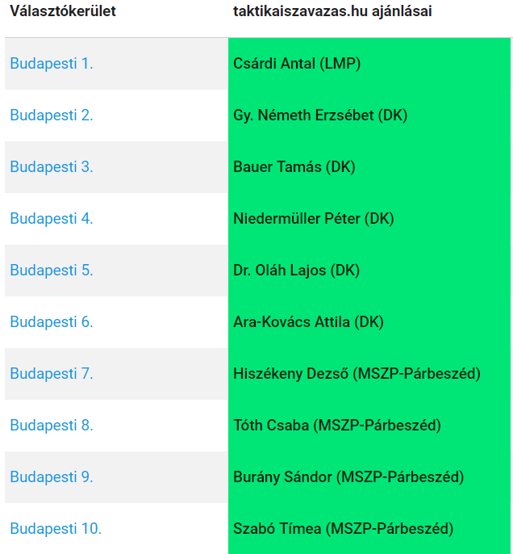
Research goals
Predict who the strongest opposition candidate is in each voting district (OEVK)
Explain why tactical voting matters in the election system
Analyze the results of the election and explain the deviations in the predicted vote shares of major parties

Slide 3
Election system overview
A new election system has been introduced in 2012 with more seats allocated as single seat constituencies (106 seats, 53% of all seats).
Voting districts have become similar in size, but demographically favored the governing party (gerrymandering)
“Winner bonus” is given to candidates who win a given seat (the vote difference between the 1st place and 2nd place candidate is added to the party list of the winning party)
There is only one round of voting making tactical voting essential for opposition parties to contest single seats

Slide 4
Tactical voting overview
Several tactical voting initiatives have been launched in March 2018 such as rendszervaltas2018.hu, v18.hu, taktikaiszavazas.hu and kireszavazzunk.hu
Each site promoted the list of most likely strongest candidates (with kireszavazzunk.hu and taktikaiszavazas.hu posting predicted vote shares and analysis in each OEVK)

Slide 5
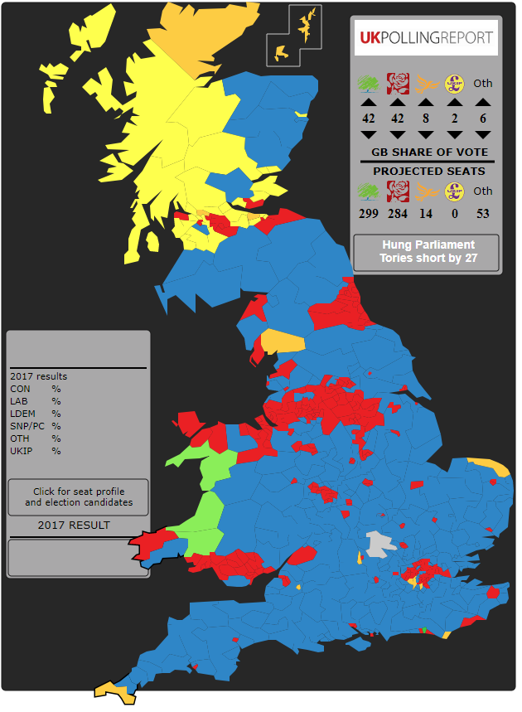
Pre-election predictions – uniform national swing (UNS) model
UNS baseline was the 2014 results in each voting district
20 OEVK polls done by the Közös Ország Mozgalom (Common Country Movement) was used to predict national levels of support
Expected vote shares have been adjusted based on previous polling errors
Vote shares of smaller parties (MKKP, Együtt, Momentum) have been derived from the 2014 vote share of LMP (most small parties targeted the same voter group as LMP)
OEVK results were adjusted based on the expected tactical voting numbers in each district (clear two-way race and close contests would increase the likelihood of tactical voting)

Slide 6
Election results
Party | Vote share % | Deviation from prediction
Fidesz | 47.71% | +5.71%
Jobbik | 19.95% | -2.05%
MSZP | 12.5% | -0.04%
LMP | 7.36% | -1.14%
DK | 5.62% | -1.88%
Momentum | 3.19% | +0.19%
Együtt | 0.68% | -1.32%
MKKP | 1.80% | +0.80%
Other minor parties | 1.23% | -

Slide 7
Party strength by different segmentations
Fidesz has performed much better in rural areas and performed worse (but still getting high support) in most cities
Jobbik lost its voters to Fidesz in key districts (Fidesz took 15 more seats from Jobbik than expected)
Left-wing parties could not win all seats in Budapest, only 12 of 18
OEVK profile (0 to 6 scale based on constituency type where 0 = Budapest districts, 6 = almost exclusively small villages in a given district) has shown strong correlation with all parties’ vote shares (left-wing parties performing well in single city and Budapest district OEVKs while Fidesz and Jobbik performing well in rural or mixed OEVKs)

Slide 8
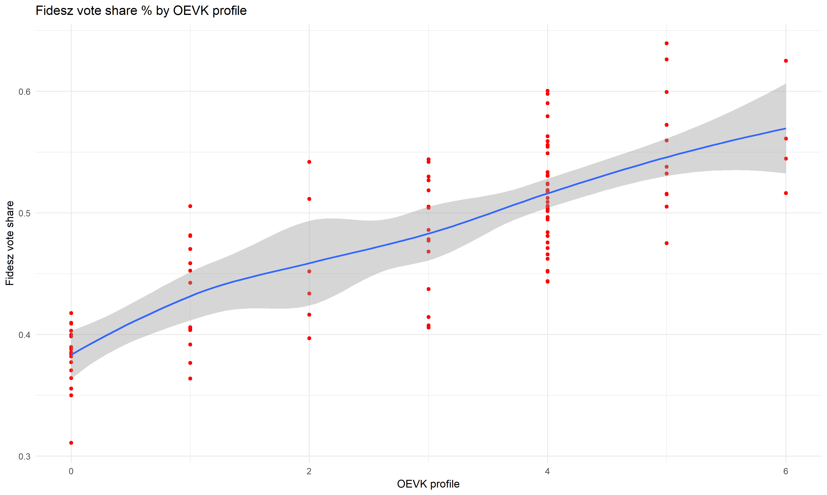

Slide 9
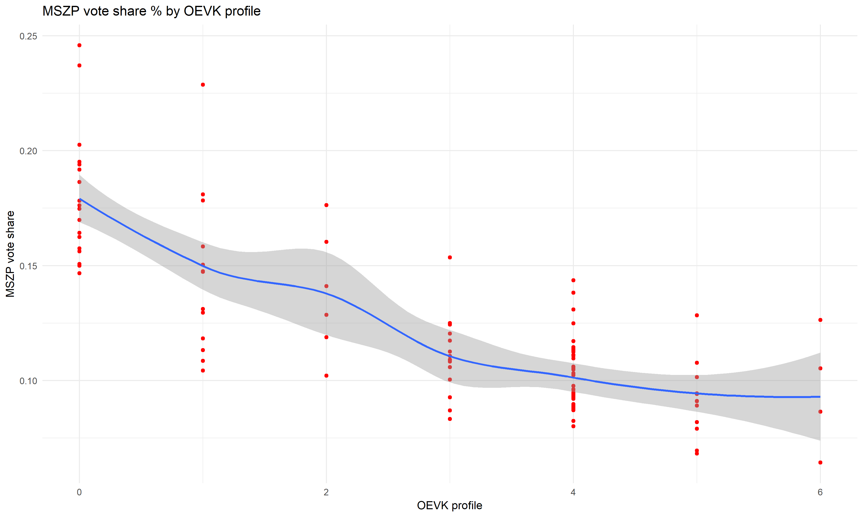

Slide 10
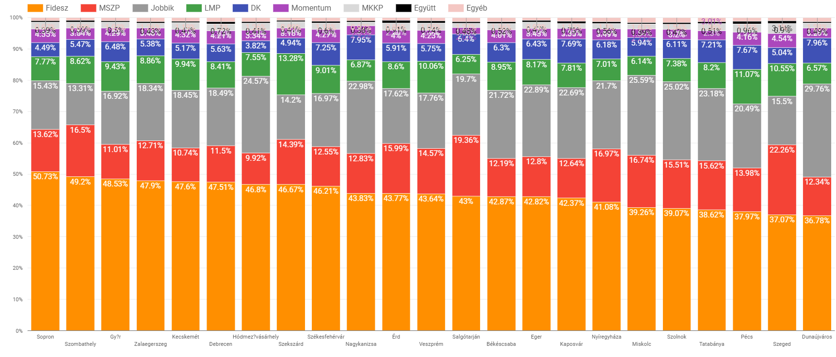

Slide 11
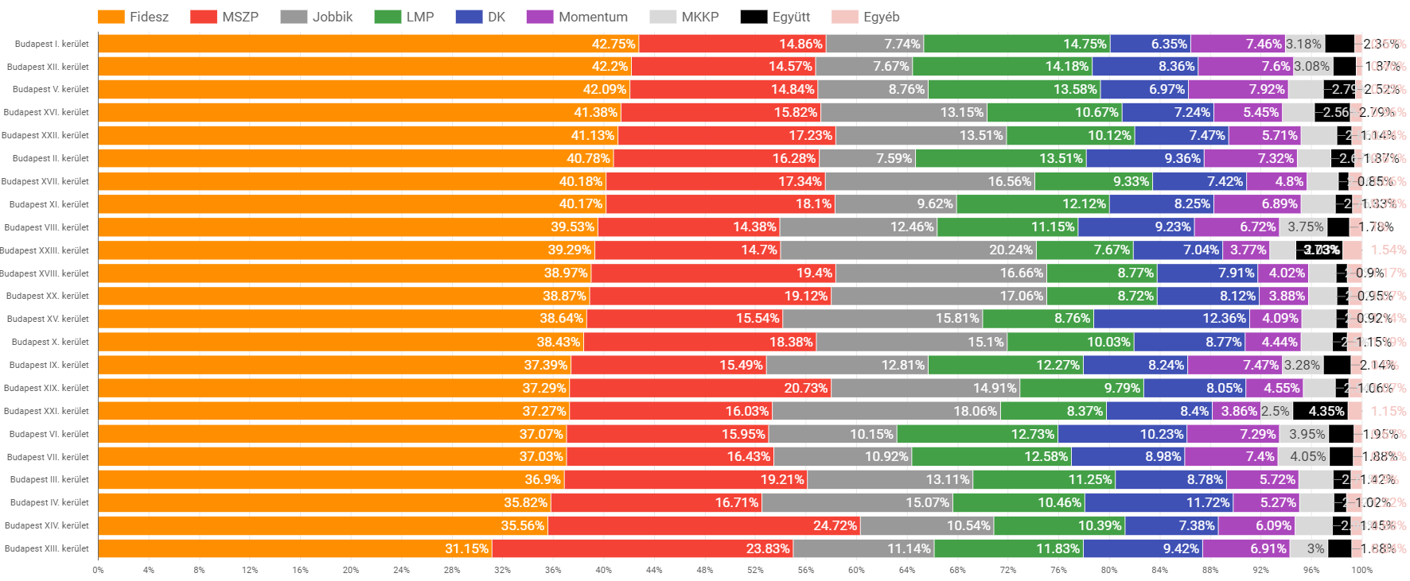

Slide 12
Detailed tactical voting analysis
Voters of smaller parties voted tactically in most cases
Tactical voting was more common in major cities than in smaller towns
The strongest opposition candidate was indeed the strongest in 90% of the cases (in 94 out of 106 OEVK)
More than 600,000 people voted tactically (which resulted in a net vote gain of 497,000 votes)
Tactical voting numbers were the highest in Budapest, in major cities and in some districts that could have been taken by Jobbik

Slide 13
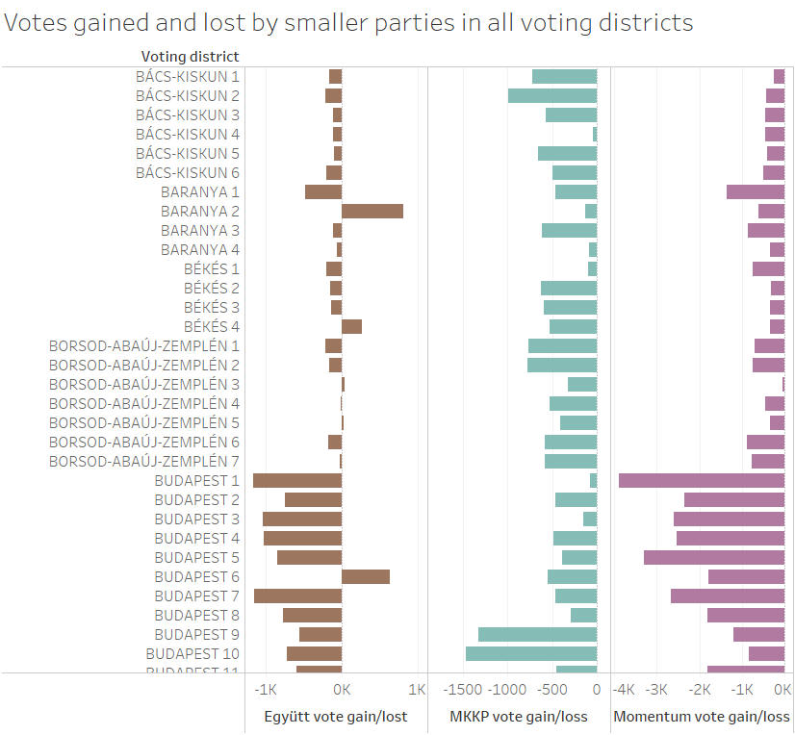
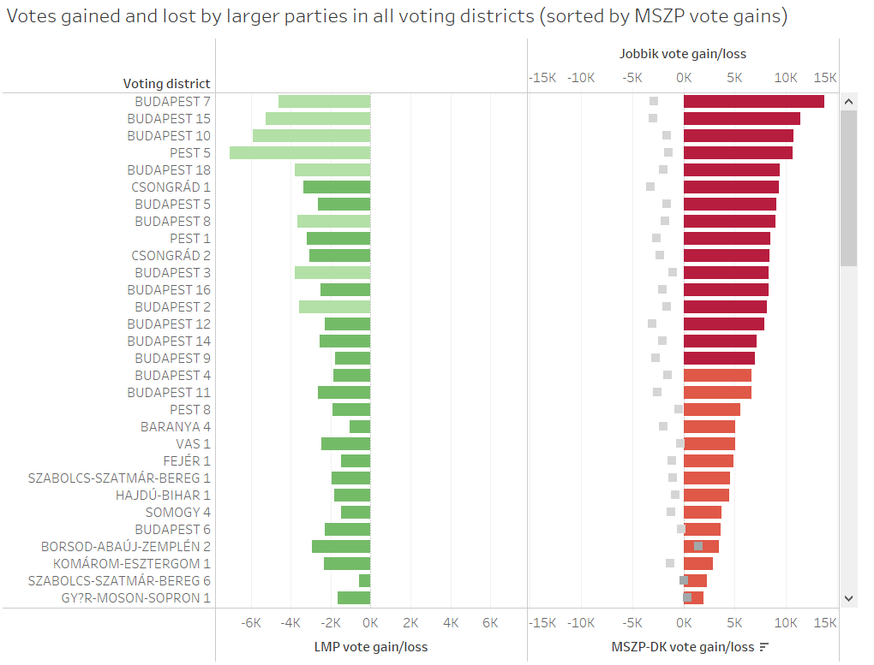

Slide 14
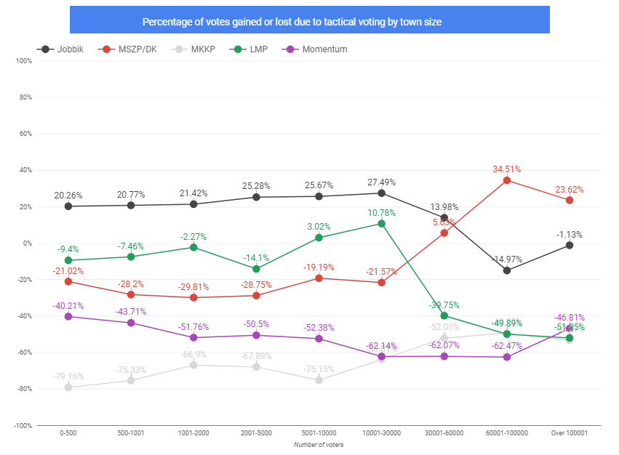

Slide 15
Deviation from predictions
The vote share of Fidesz was underpredicted while Jobbik was overpredicted
Left-wing opposition parties performed slightly worse than expected
Most common deviation was in Jobbik’s target districts where Fidesz gained voters from Jobbik (thus securing key rural seats)

Slide 16
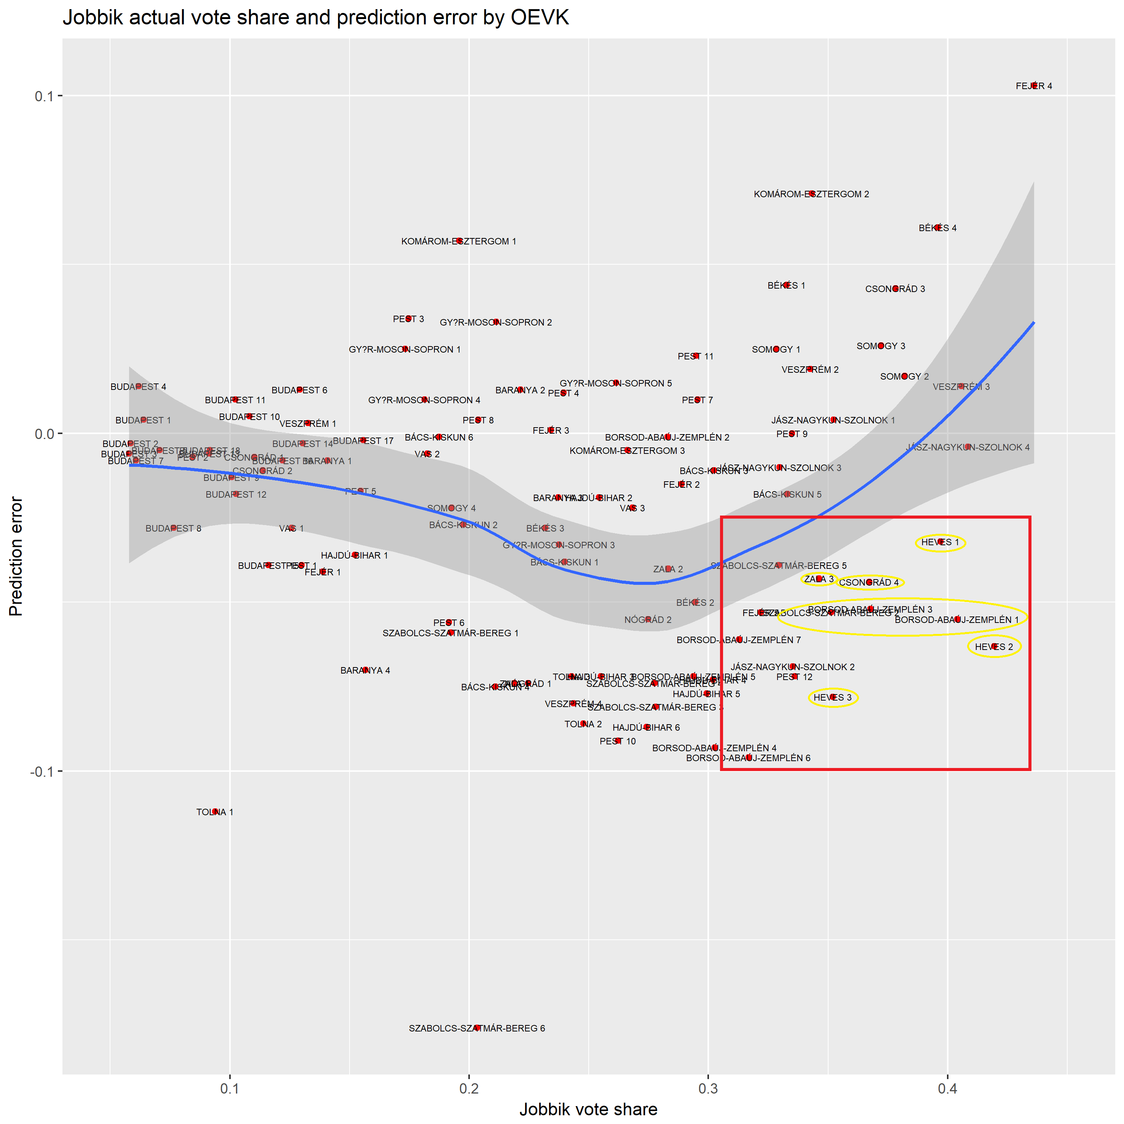
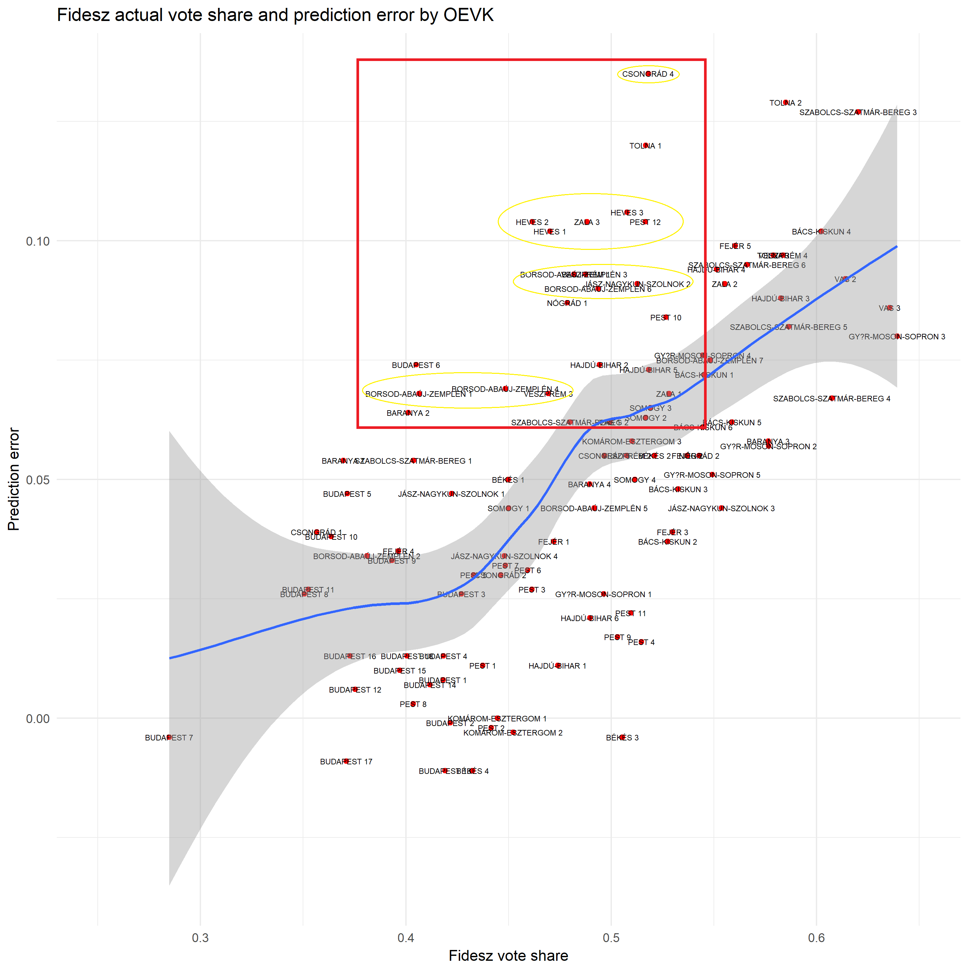

Slide 17
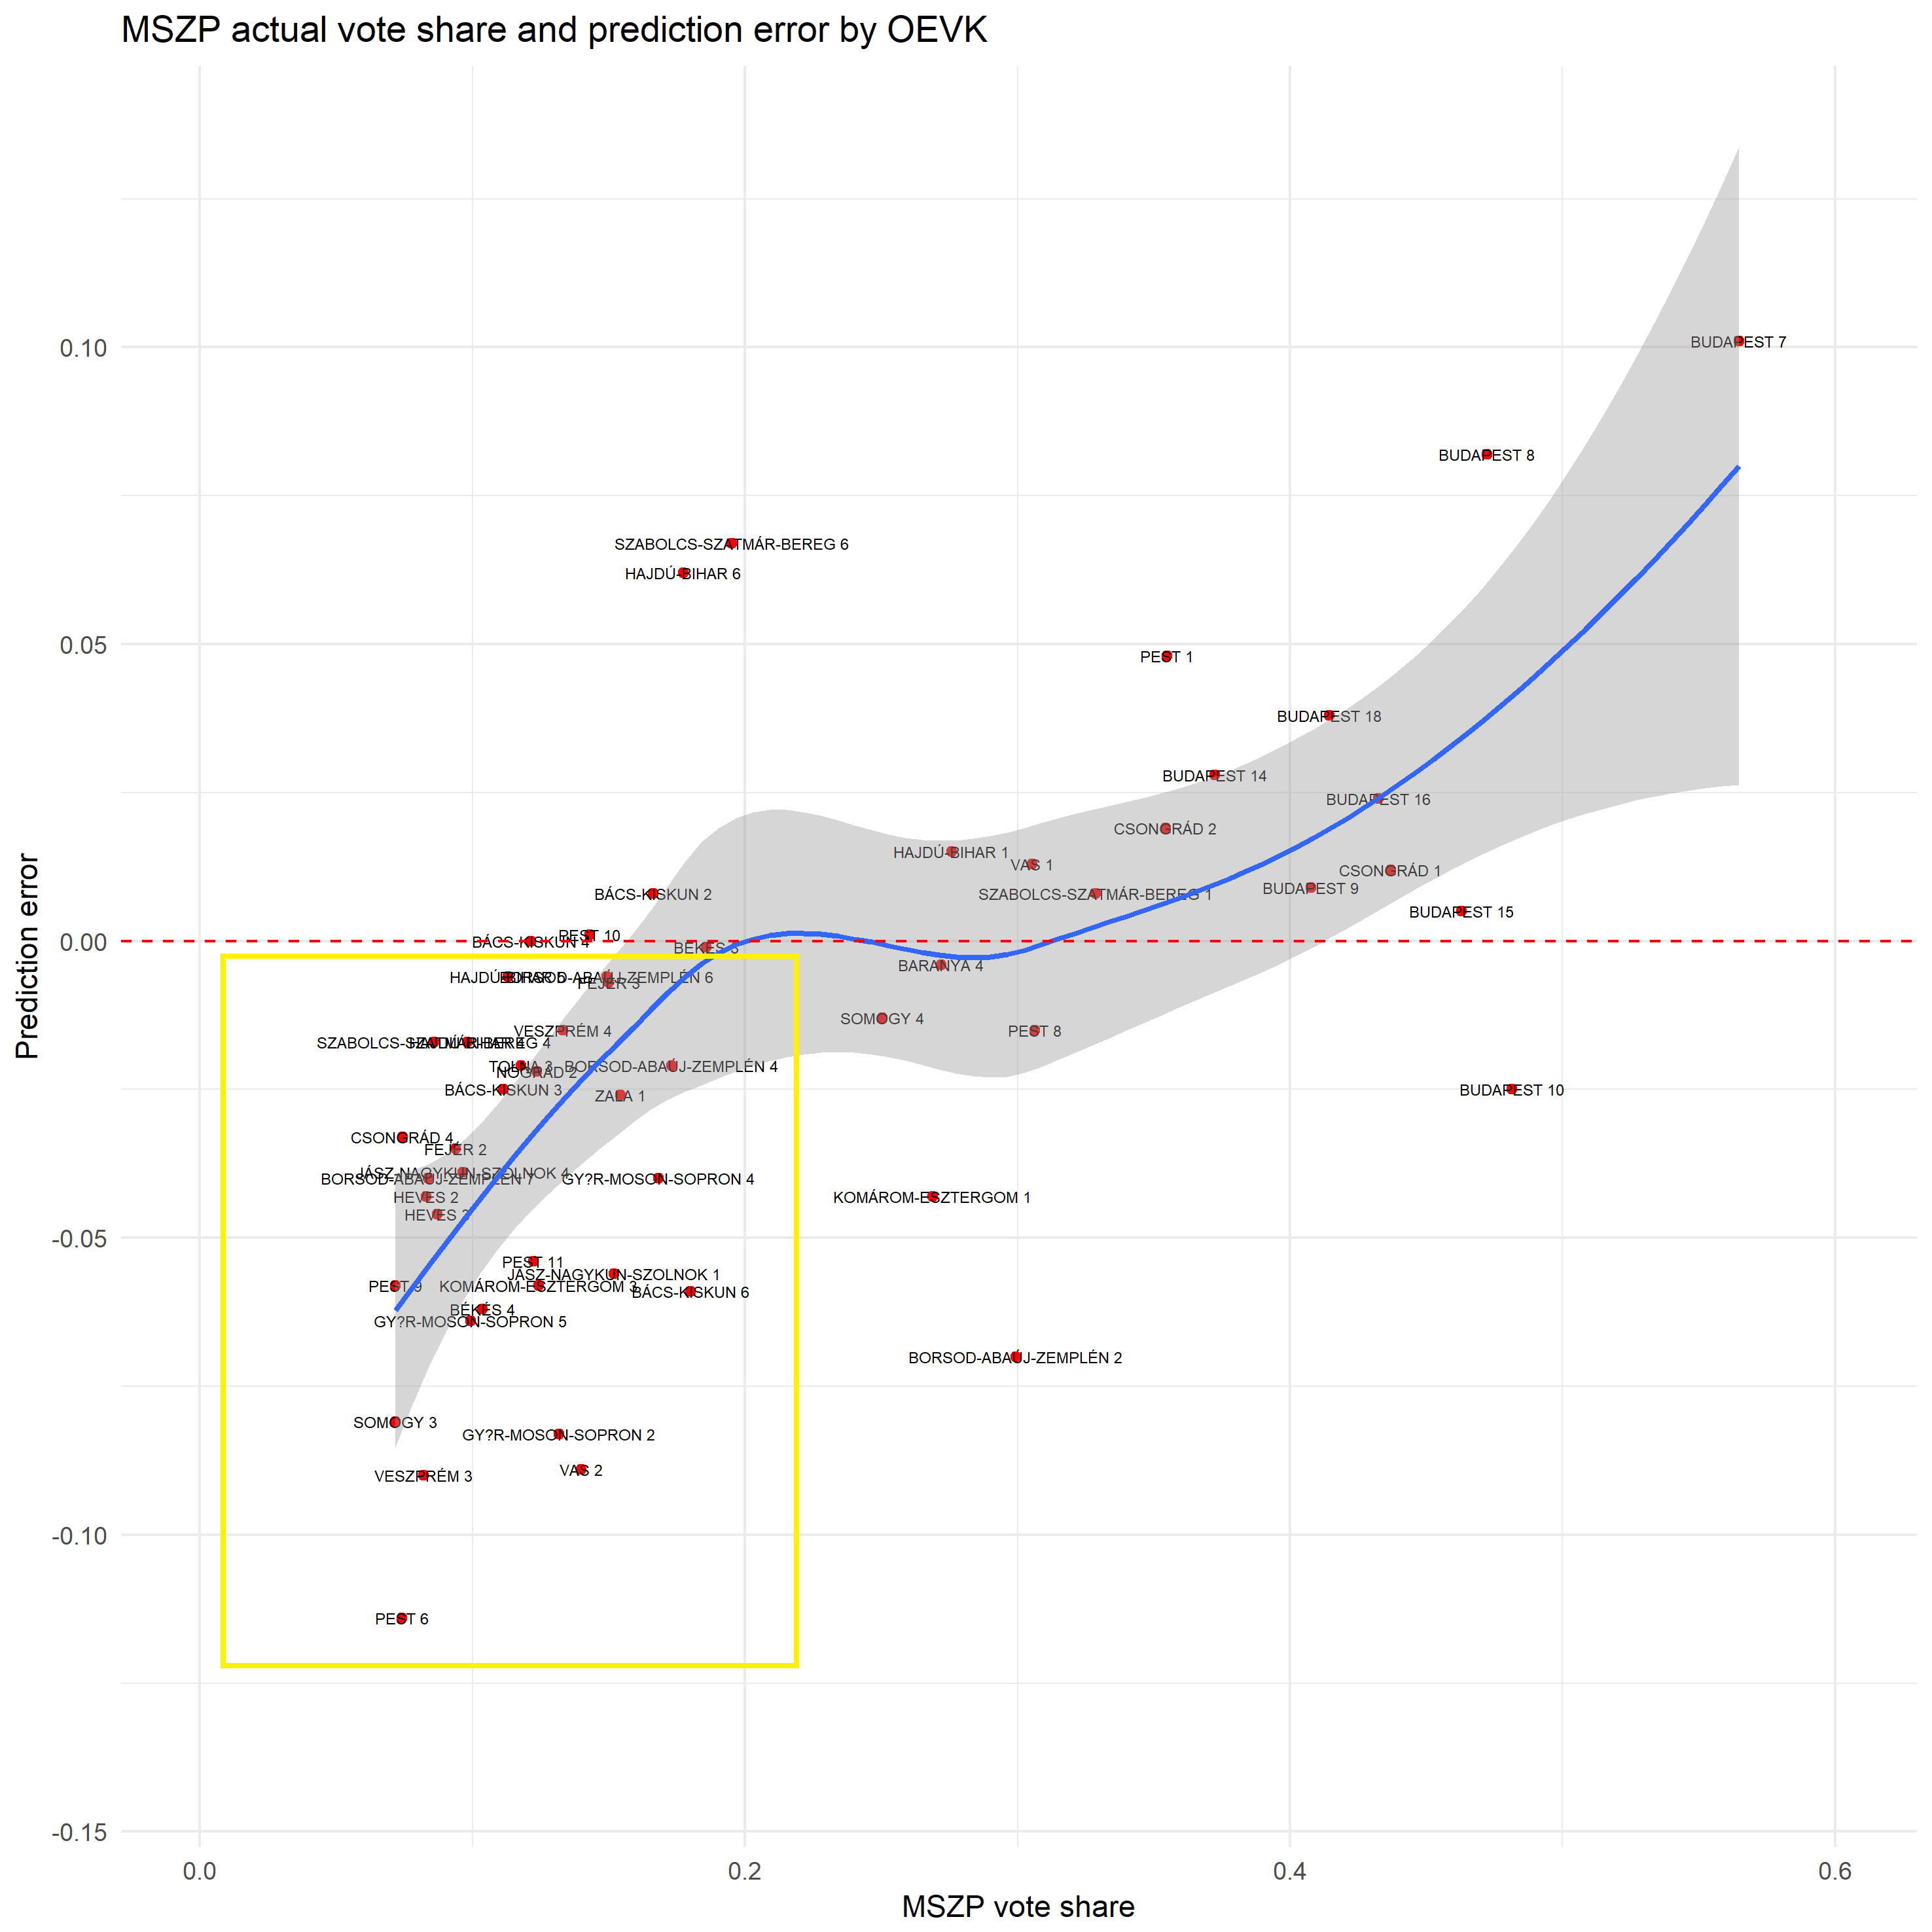
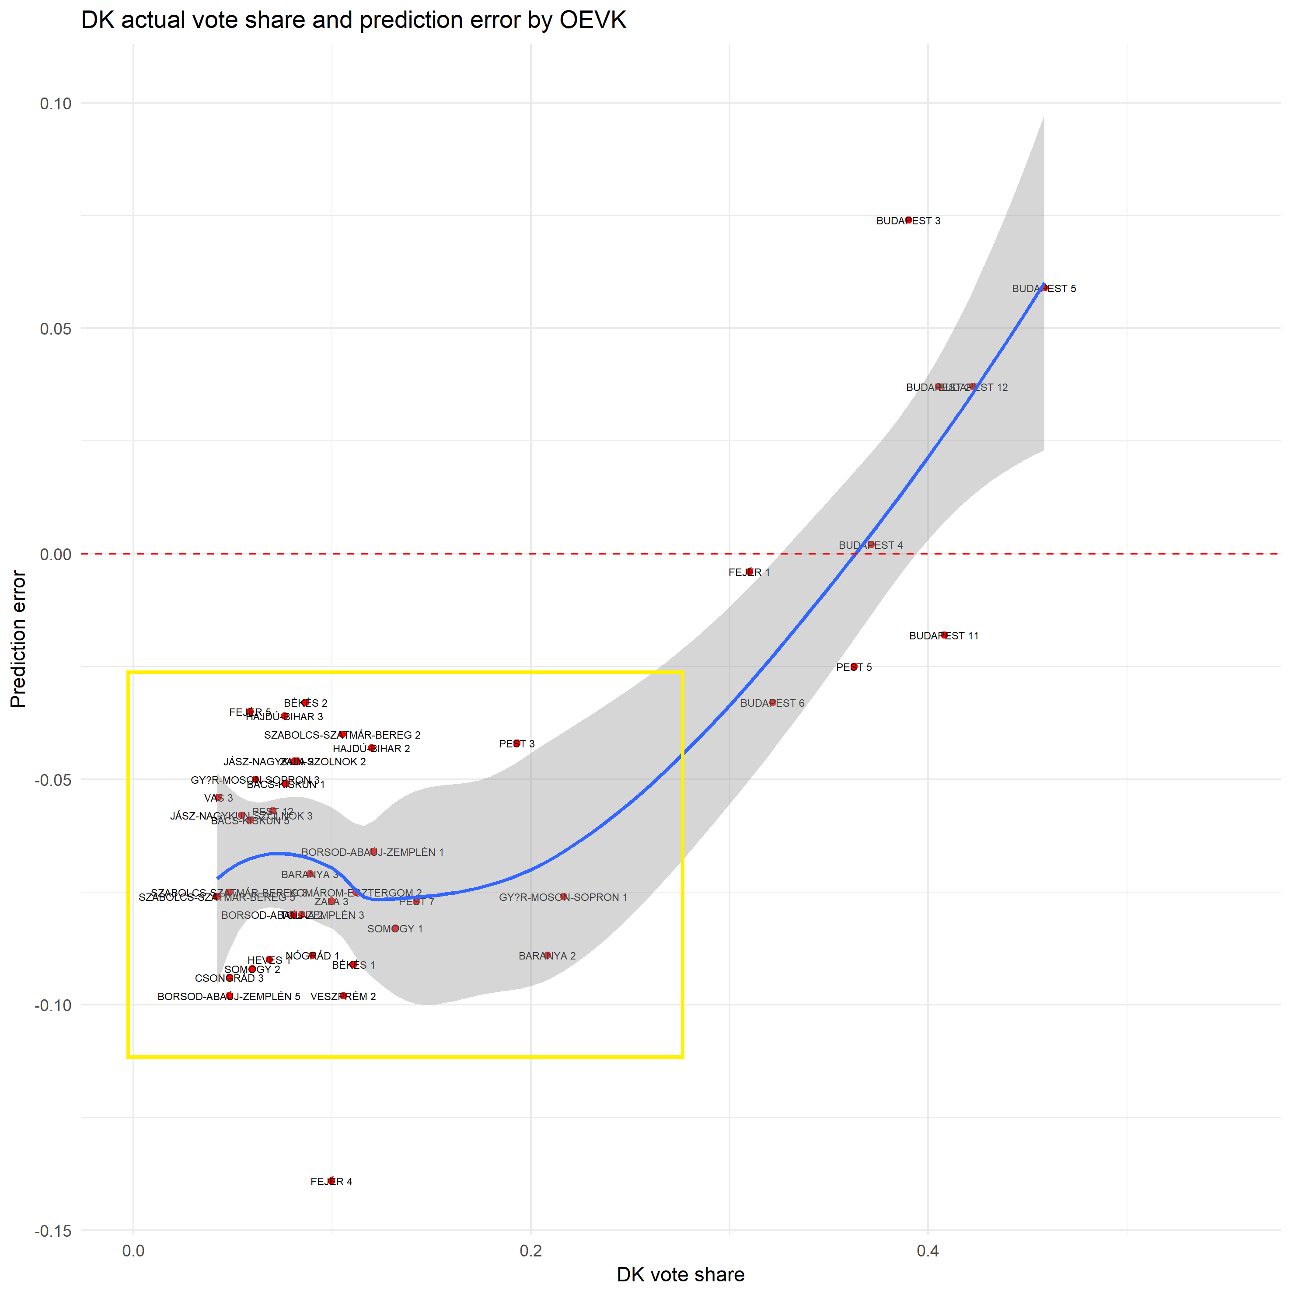

Slide 18
Post-election models (2014 vs 2018)
Models
GLM prediction using KSH (statistical office) data
Simple UNS prediction
Results
Fidesz took target Jobbik seats and some major cities (Békéscsaba and Miskolc) exceeding expectations
Jobbik got extra votes through tactical voting, but it was not enough to win seats
MSZP/DK gained several seats in Budapest thanks to tactical voting

Slide 19
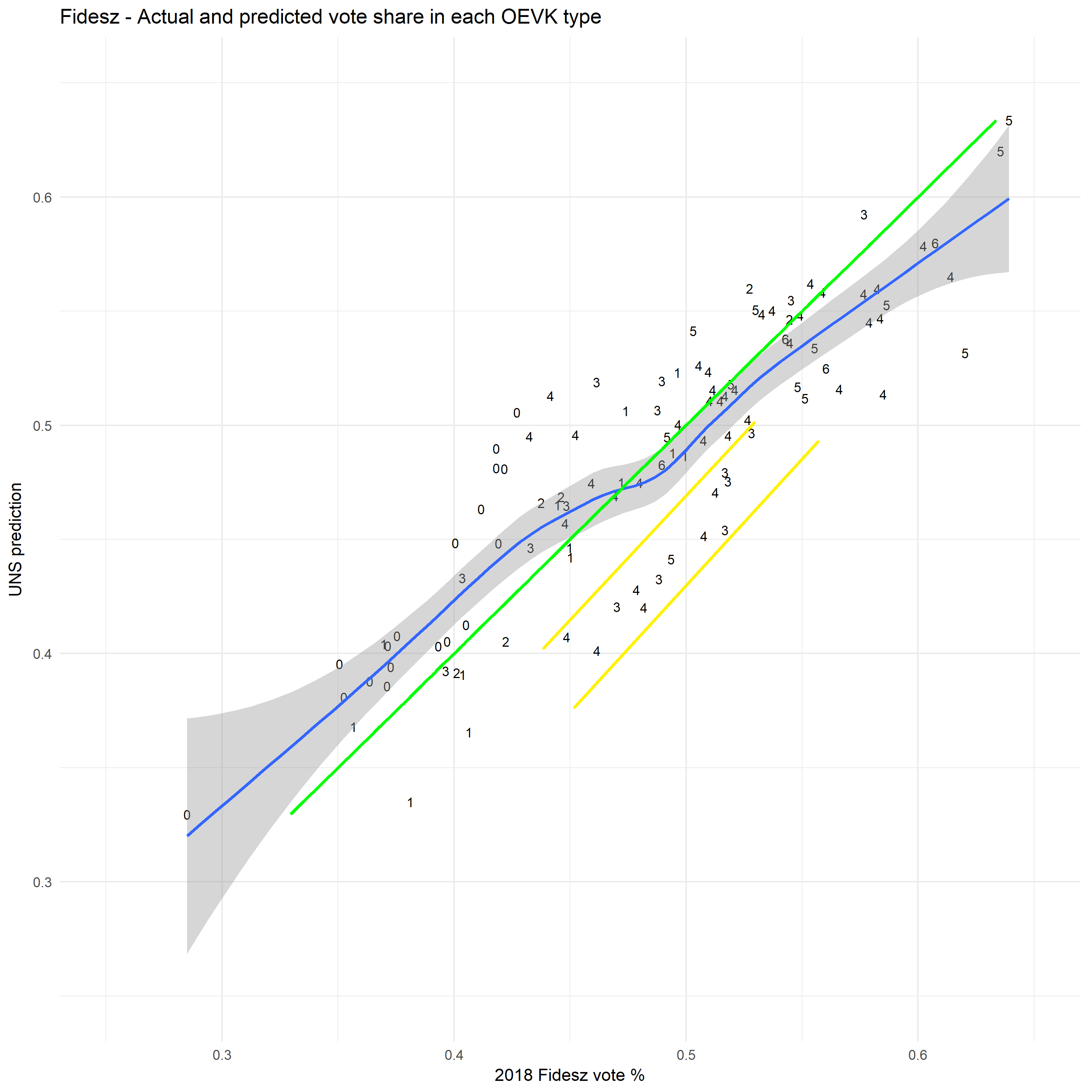
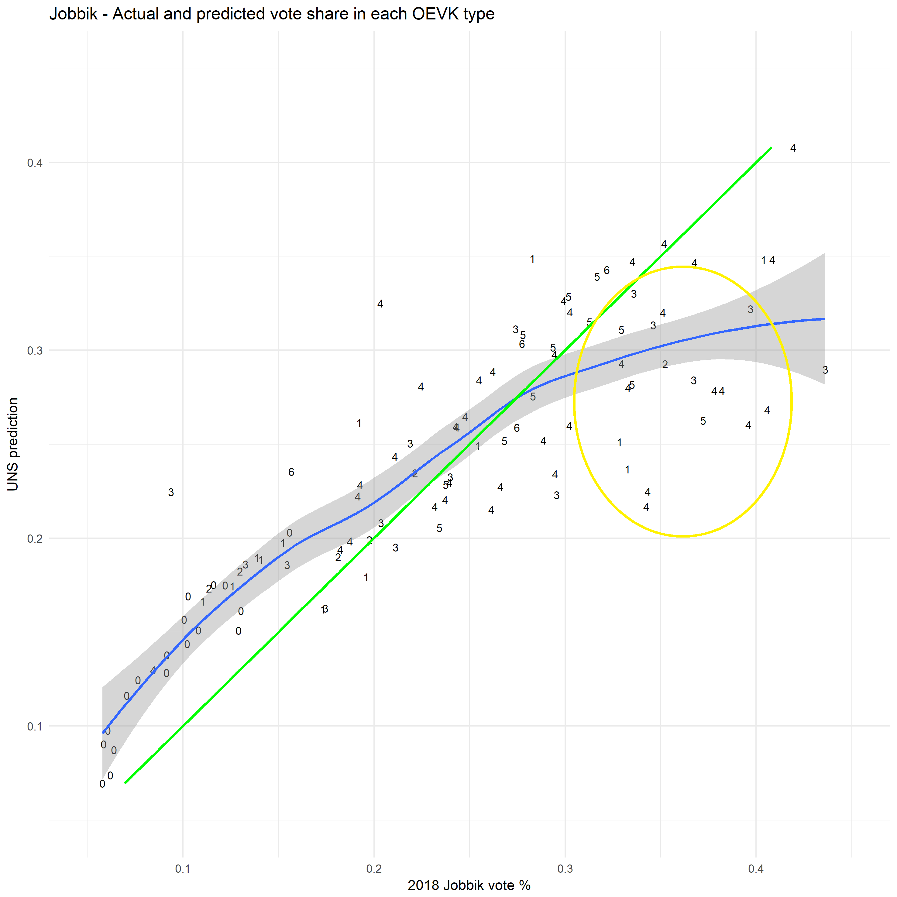

Slide 20
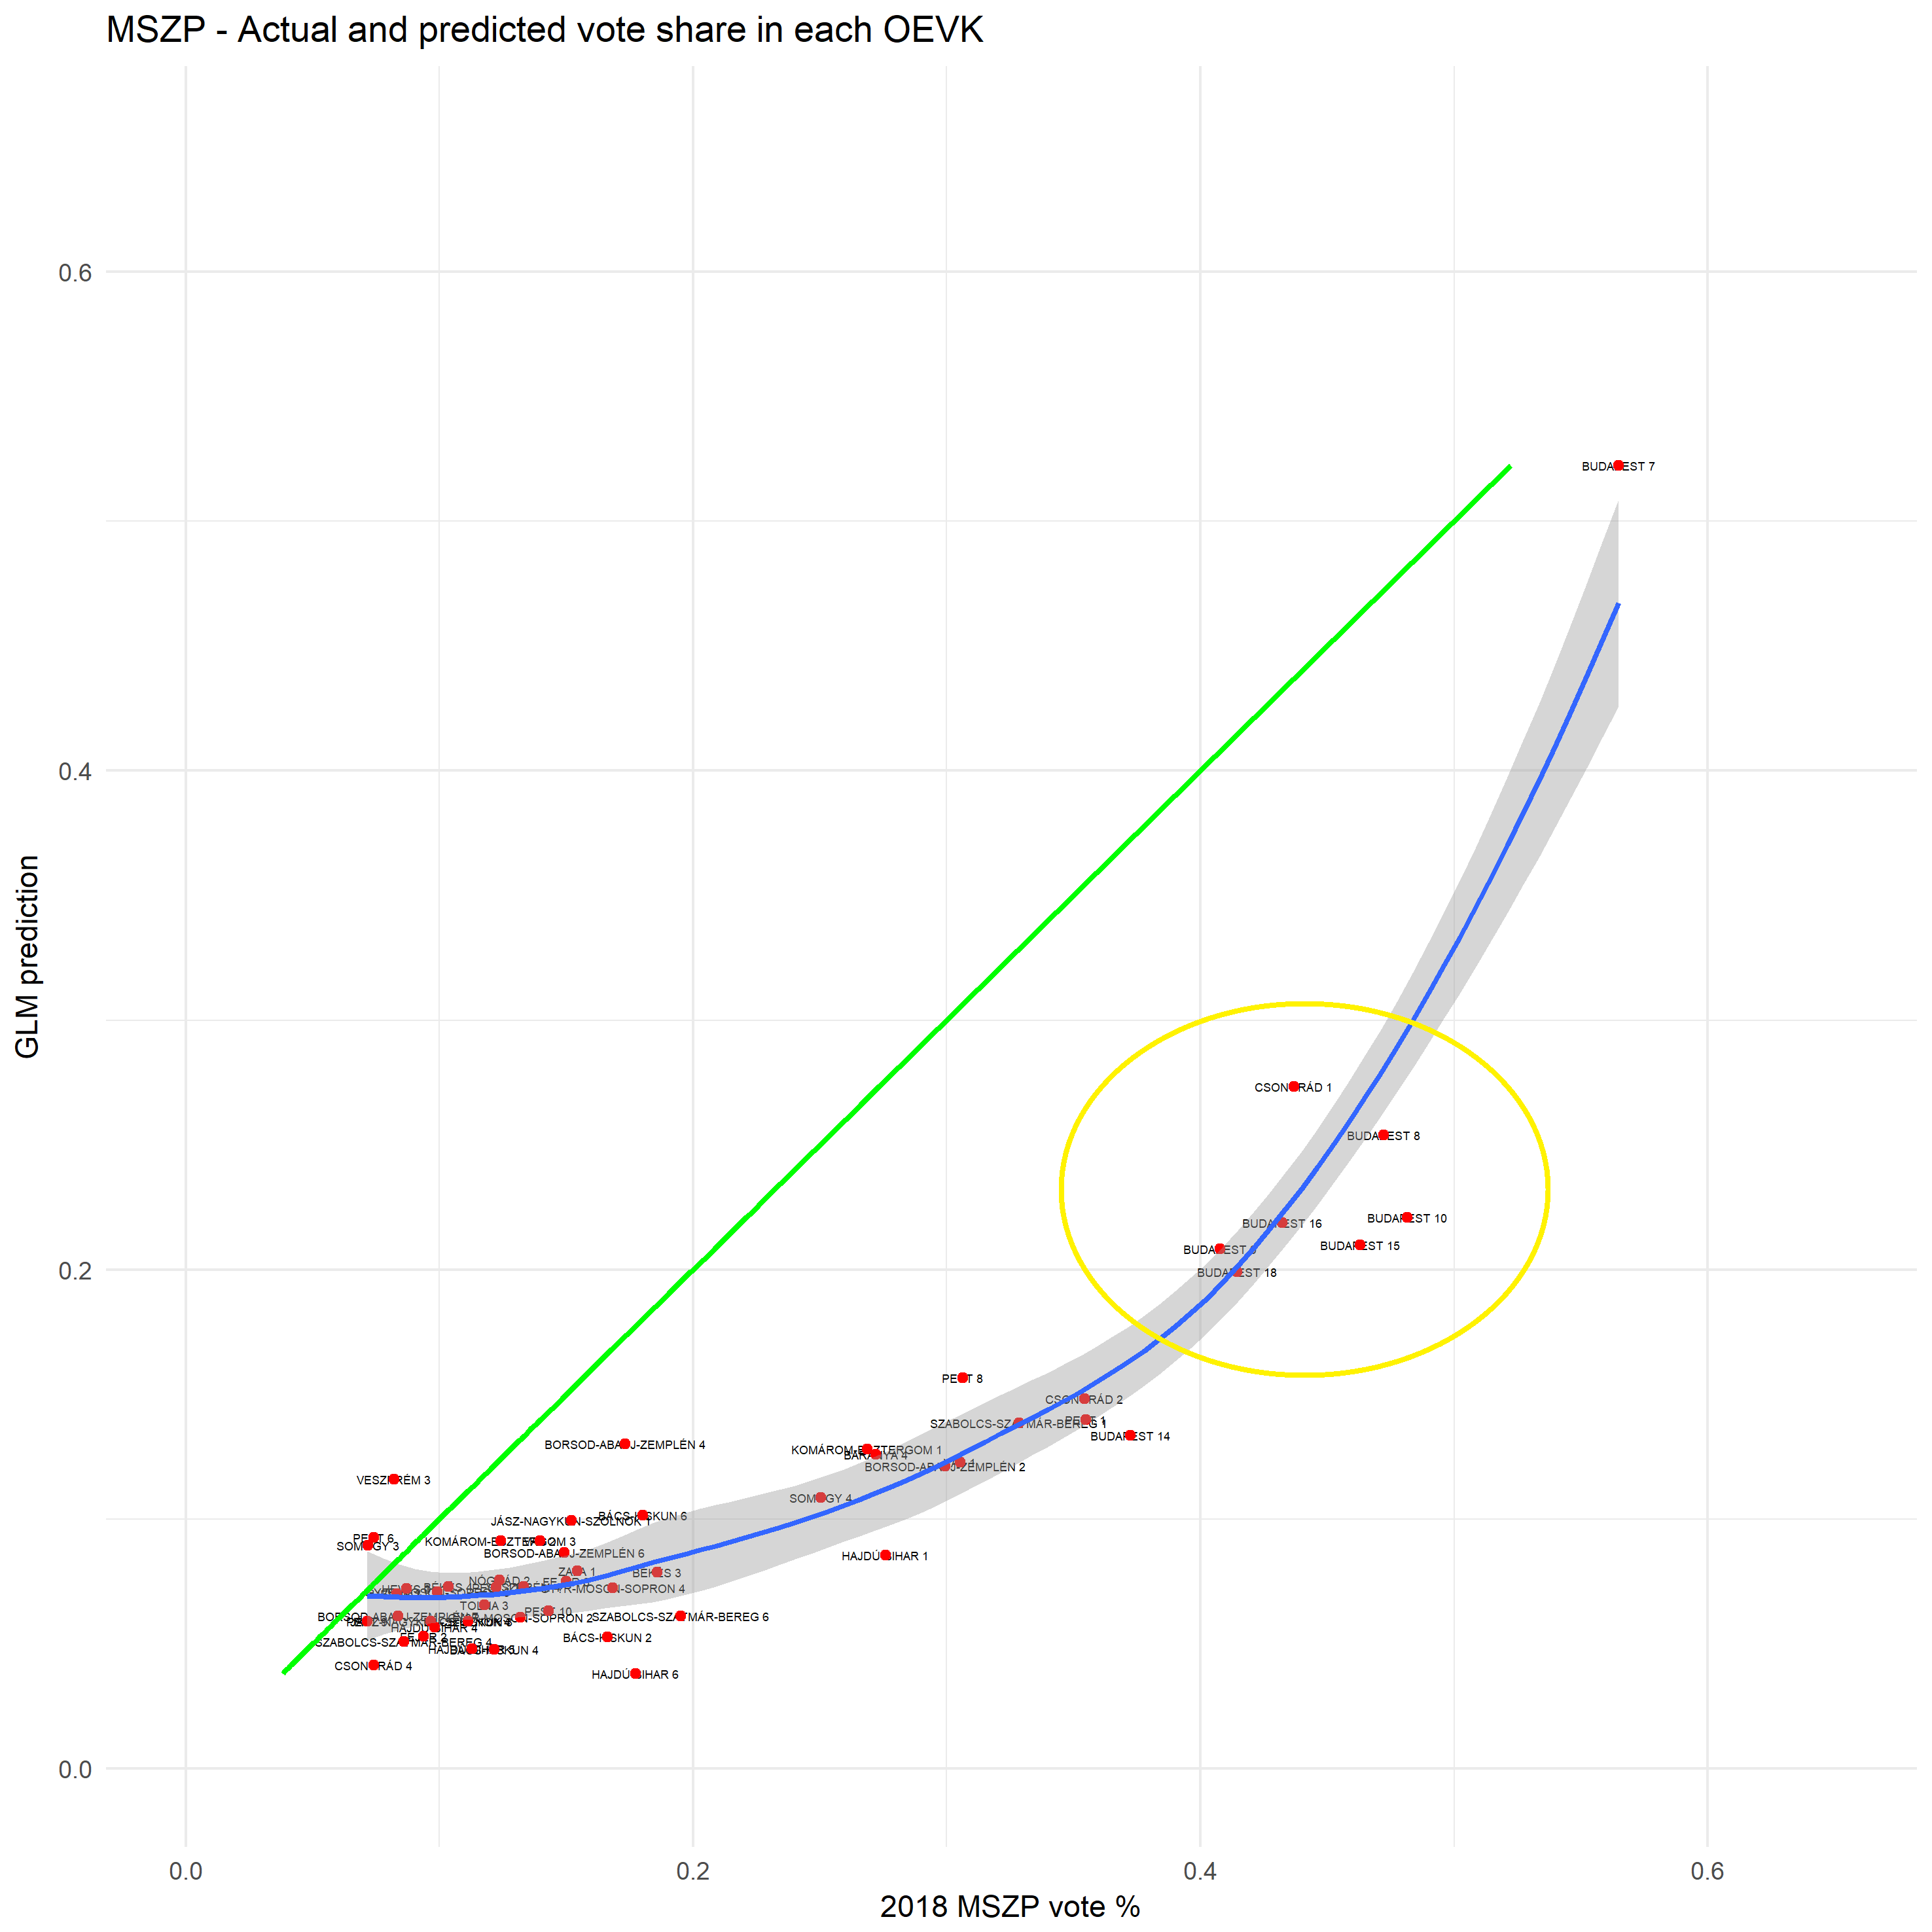

Slide 21
Further research potential
Investigate electoral fraud cases
Improve the logistic model to understand more about voter types

